Slide 1
Data Science Salaries

Slide 2
Data Introduction
Gathered data using a small population of 603 Data Scientists from around the world
Depending on your desired employment type, which pays the most?
What are typical salaries for Data Scientists?
What are the projected salaries for Data Scientists in the future?

Slide 3


Slide 4
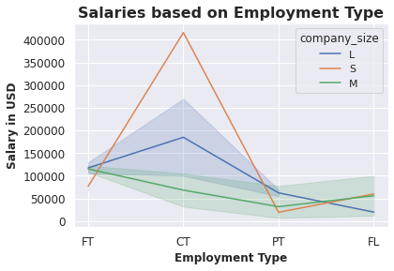
Contract Data Scientists earned higher salaries
Large Companies pay Data Scientists higher salaries

Slide 5
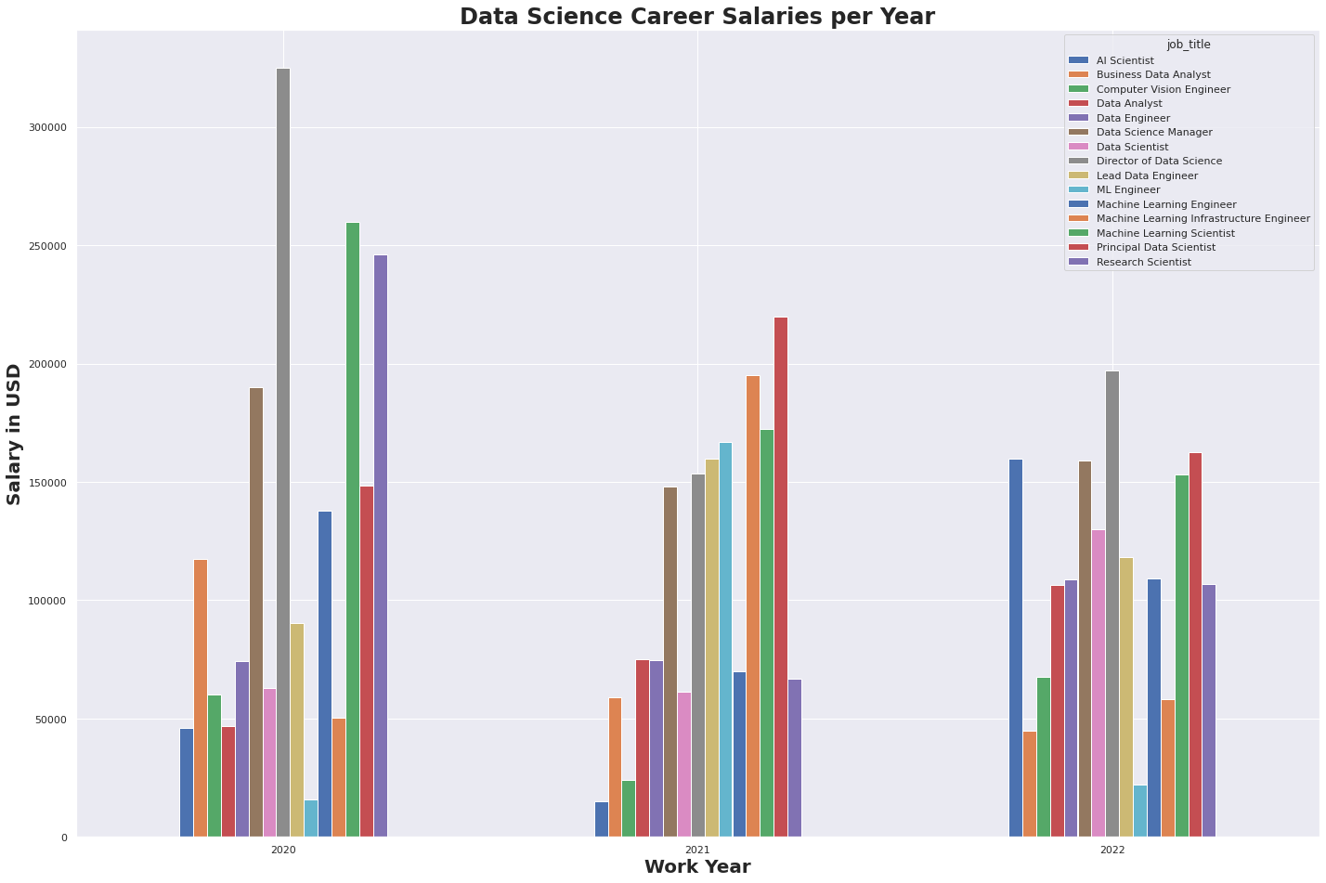
Directors of Data Science tend to earn the highest consistent salaries
Data Science Managers earn most consistent salary
Data Analysts & Data Scientists have seen a steady increase in salaries over past 2-3 years

Slide 6
Model Strengths & Limitations
Strengths
Projected salaries would give you an idea of which Data Science career to focus on
Limitations
With small amount of data provided, model would have a margin of error of $6.5k

Slide 7
Conclusion
If wanting to start off in the Data Science Industry
Data Analyst: regardless if it’s a startup or big tech
Data Scientist: steady salary with potential salary increase in few years

